Slide 1
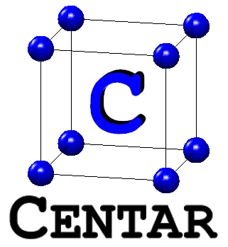
Efficient Circuit Architecture and FPGA Implementation for LTE Single Carrier FDMA DFT
J. Greg Nash
www.centar.net
jgregnash@centar.net
SOCC 2016

Slide 2
Outline
Motivation?
Wireless protocol: LTE Single Carrier Frequency Division Multiplex
Review of FFT architectures
New FFT architecture
Circuit FPGA performance comparisons
  Altera
  Xilinx
Conclusions

Slide 3
Motivation
Future connectivity
  “Internet Of Things”, e.g., every device with on/off switch gets connected to the internet
  Gartner says that by 2020 there will be over 26 billion connected devices
  Wireless OFDM protocols (LTE,… etc.) are responsible for mobile connections
Expanding FPGA markets
  Altera: 44% sales in Telecom and Wireless
  Growth in mobile applications for FPGAs (Lattice Semiconductor)

Slide 4
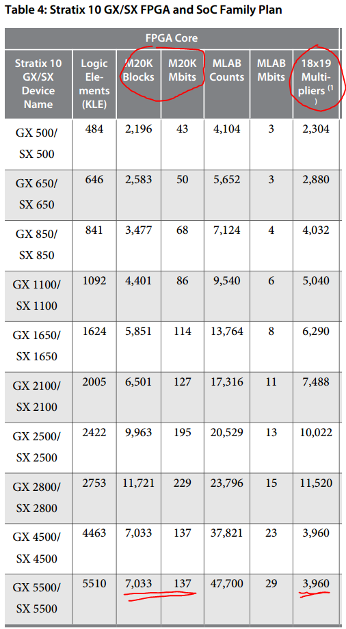
FPGA Design Goals
Future FPGAs →
  Large numbers of embedded elements
  Embedded elements are power efficient:
Design conclusions
  “Use them or lose them”
  Taking architectural tradeoffs that use embedded elements can lead to better designs
  Potential reduced power usage
Source | Power (mW)
Block RAM | 158
Multiplier | 80
LUT/Register | 1186
128:2048 Point FFT

Slide 5
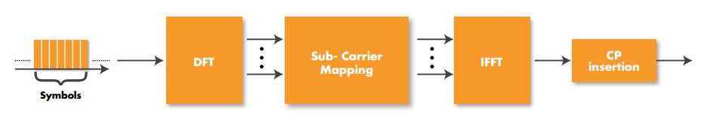
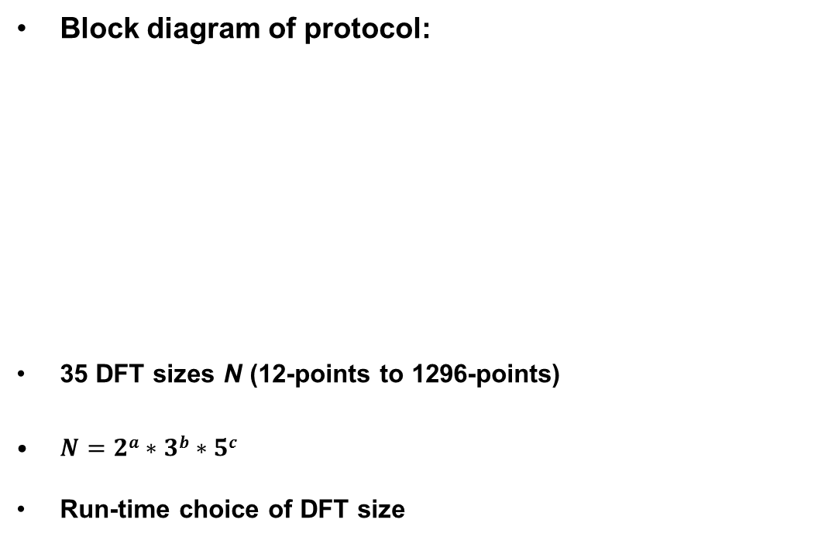
LTE Uplink: Single Carrier FDMA
Block diagram of protocol:
35 DFT sizes N (12-points to 1296-points)
$N=2a∗3b∗5c$
Run-time choice of DFT size

Slide 6
LTE Resource Block
One downlink slot, 0.5ms
6 or 7 OFDM symbols
Resource block
:
Frequency
12 subcarriers
:
l=0
Time
l=6

Slide 7
FFT Architecture Review: Memory Based
Traditional
Proposed Array Based
Features
Can be programmable
Compact
Typically slow
Features
Programmable
Simple
Faster than pipelined FFTs
Scalable
Higher SQNR

Slide 8
Matrix Form DFT (16-Point DFT)
Z = C X
W=e^{-2πI/N}
(N=16)

Slide 9
After Some “base-4” Transformations
(N=16)
“ ”= element by element
multiply

Slide 10
New FFT Matrix Form
“ ”= element by element
multiply
(for b=4)

Slide 11
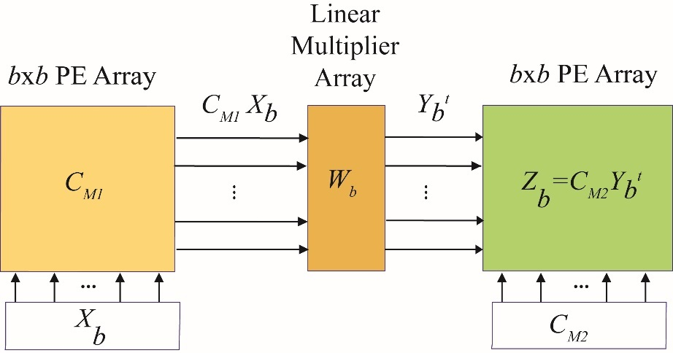
“Base-b” FFT Architecture
Base-b DFT equations:
Base-4 DFT architecture:

Slide 12
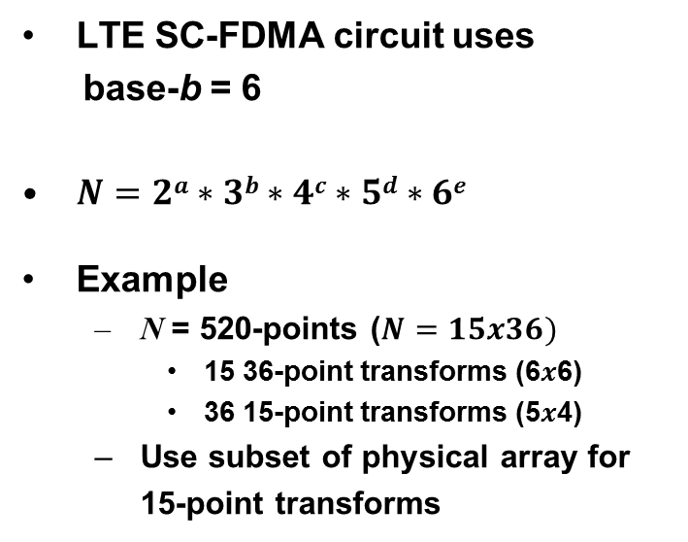
Circuit Array DFT Example
LTE SC-FDMA circuit uses
base-b = 6
$N=2a∗3b∗4c∗5d∗6e$
Example
  N = 520-points ($N=15x36)$
    15 36-point transforms (6$x$6)
    36 15-point transforms (5$x$4)
  Use subset of physical array for
  15-point transforms
36-pt
DFTs
15-pt
DFTs

Slide 13
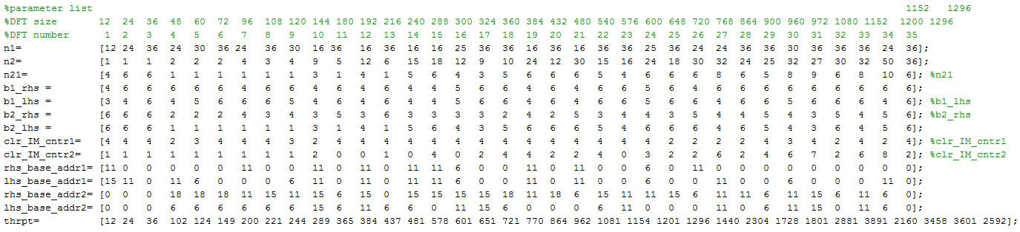
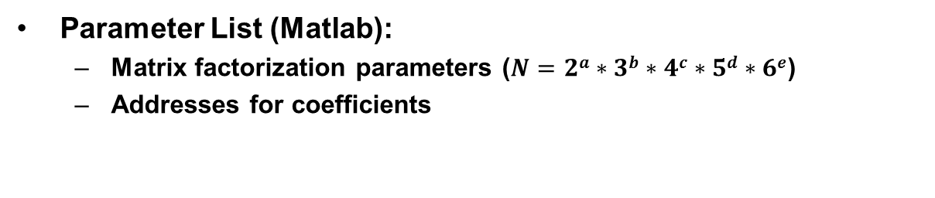
Programmability
Parameter List (Matlab):
  Matrix factorization parameters ($N=2a∗3b∗4c∗5d∗6e$)
  Addresses for coefficients
240 points

Slide 14
FPGA Circuit Usage Comparisons: Altera
Altera Quartus II Tools EP3SE110F780C2 FPGA (65nm technology)
Functionality not quite the same:
  Altera circuit doesn’t do 1296 points
  Altera circuit doesn’t provide normal outputs (need ~5 Block RAMs to do this plus logic)
With more data streams:
Design | FPGA | LUT | Registers | Block RAM (9K) | Multipliers (18-bit) | Fmax (MHz) | RB Average Throughput (cycles) | Throughput (Normalized)
Centar | Stratix III | 3816 | 3188 | 29 | 60 | 400 | 16.6N | 1
Altera | Stratix III | 2600 | N/A. | 17 | 32 | 260 | 32.9N | 0.33
Number MIMO Streams | Sectors | Total RB | Altera Cores Required | Centar Cores Required | LUT Altera::Centar | Block RAM Altera::Centar | Multipliers Altera::Centar
1 | 1 | 1 | 1 | 1 | 1.00::1.47 | 1.00::1.32 | 1.00::1.875
2 | 1 | 2 | 1 | 1 | 1.00::1.47 | 1.00::1.32 | 1.00::1.875
4 | 1 | 4 | 2 | 1 | 1.36::1.00 | 1.52::1.00 | 1.07::1.00
1 | 3 | 3 | 2 | 1 | 1.36::1.00 | 1.52::1.00 | 1.07::1.00
2 | 3 | 6 | 3 | 1 | 2.04::1.00 | 2.27:1.00 | 1.60::1.00
4 | 3 | 12 | 4 | 2 | 1.36::1.00 | 1.52::1.00 | 1.07::1.00

Slide 15
FPGA Circuit Usage Comparisons: Xilinx
Both designs use Xilinx ISE tools
Xilinx DFT from LogiCORE IP v3.1
Virtex-6 FPGA target hardware
Xilinx DFT uses 66% more registers, 32% more LUTs
Centar design is 41% faster
Block RAM Xilinx advantage mitigated by multi-core processing
Design | FPGA | LUT | Registers | Block RAM (18K) | Multipliers (18-bit) | Fmax (MHz) | RB Average Throughput (cycles) | Throughput (Normalized)
Centar | Virtex-6 | 2915 | 2581 | 19 | 72 | 401 | 16.6N | 1
Xilinx | Virtex-6 | 3851 | 4326 | 10 | 16 | 403 | 23.4N | 0.71

Slide 16
Conclusion: Better SC-FDMA FFTs are Possible for FPGA Hardware
Improved performance: algorithmic reduction in computation cycles
Reduced usage of FPGA logic elements
Programmability (Xilinx and Altera designs hardwired)
Throughput scalability due to the use of array-based algorithms
Higher dynamic range (smaller word lengths needed)
Power-of-two computations can be done as well

