Slide 1

High-Throughput Programmable Systolic Array
FFT Architecture and FPGA Implementations
J. Greg Nash
www.centar.net
jgregnash@centar.net
ICNC 2014

Slide 2
Outline
Motivation for new FFT designs in wireless applications?
Review of FFT architectures
New systolic FFT architecture
Circuit FPGA performance comparisons
  LTE SC-FDMA
  Fixed-size power-of-two transforms
  Variable transforms (LTE, WiMAX)
Conclusions

Slide 3
Future Drivers for Wireless FFT Design
Algorithmic (OFDM)
  Large transform sizes (LTE: 2048 points; DVB: 32K points)
  Run-time scalable OFDMA (LTE : 128 to 2048 points)
  Non-power-of-two transform sizes (LTE SC-FDMA: 35 sizes, 12 to 1296 points)
  High performance (LTE advanced)
    BW = 100MHz with 8 MIMO streams ⇒ <1.0μsec for 2K FFT)
Critical system requirements
  Power
  Cost

Slide 4
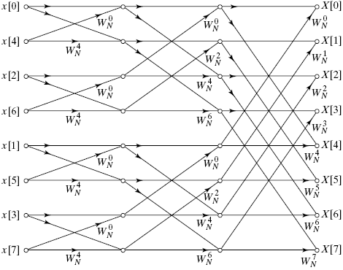
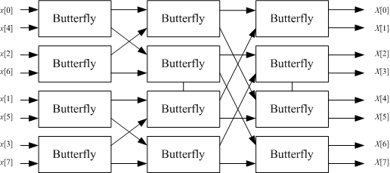

FFT Architecture Review (1): Pipelined
Signal Flow Graph (8-point DFT)
Block Diagram
W=e^{-2πI/N}
Collapse onto pipelined hardware blocks
Features
Fast
Hardware Intensive
Non-programmable

Slide 5
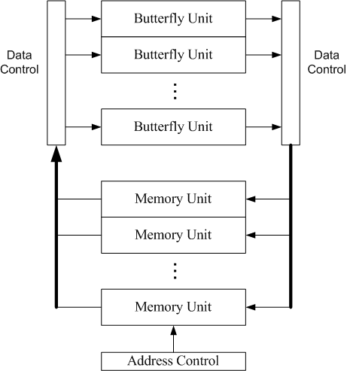
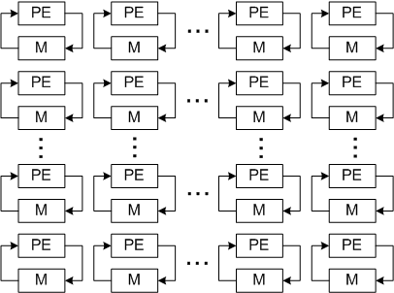
FFT Architecture Review (2): Memory Based
Traditional
Proposed Systolic Array
Features
Programmable
Faster than pipelined FFT
Scalable
Higher SQNR
Features
Programmable
Compact
Typically slow

Slide 6
Matrix Form DFT (16-Point DFT)
Z = C X
W=e^{-2πI/N}
(N=16)

Slide 7
Inputs X and Outputs Z in Bit-reversed Form
(N=16)
⎡
⎡
1
1
1
1
⎤
⎡
1
1
1
1
⎤
⎡
1
1
1
1
⎤
⎡
1
1
1
1
⎤
⎤
⎢
⎢
⎥
⎢
⎥
⎢
⎥
⎢
⎥
⎥
⎢
⎢
⎥
⎢
⎥
⎢
⎥
⎢
⎥
⎥
⎢
⎢
1
1
1
1
⎥
⎢
1
1
1
1
⎥
⎢
1
1
1
1
⎥
⎢
1
1
1
1
⎥
⎥
⎢
⎢
⎥
⎢
⎥
⎢
⎥
⎢
⎥
⎥
⎢
d1
⎢
⎥
d2
⎢
⎥
d3
⎢
⎥
d4
⎢
⎥
⎥
⎢
⎢
⎥
⎢
⎥
⎢
⎥
⎢
1
1
1
1
⎥
⎥
⎢
⎢
1
1
1
1
⎥
⎢
1
1
1
1
⎥
⎢
1
1
1
1
⎥
⎢
⎥
⎥
⎢
⎢
⎥
⎢
⎥
⎢
⎥
⎢
⎥
⎥
⎢
⎥
⎢
⎢
⎥
⎢
⎥
⎢
⎥
⎢
⎥
⎥
⎢
⎢
⎥
⎢
⎥
⎢
⎥
⎣
1
1
1
1
⎦
⎥
⎢
⎣
1
1
1
1
⎦
⎣
1
1
1
1
⎦
⎣
1
1
1
1
⎦
⎥
⎢
⎥
⎢
⎡
1
−
I
-1
I
⎤
⎡
1
−
I
-1
I
⎤
⎡
1
−
I
-1
I
⎤
⎡
1
−
I
-1
I
⎤
⎥
⎢
⎢
⎥
⎢
⎥
⎢
⎥
⎢
⎥
⎥
⎢
⎢
⎥
⎢
⎥
⎢
⎥
⎢
⎥
⎥
⎢
⎢
−
⎥
⎢
−
⎥
⎢
−
⎥
⎢
−
⎥
⎥
⎢
⎢
1
I
-1
I
⎥
⎢
1
I
-1
I
⎥
2
⎢
1
I
-1
I
⎥
3
⎢
1
I
-1
I
⎥
⎥
⎢
d1
⎢
⎥
W
d2
⎢
⎥
W
d3
⎢
⎥
W
d4
⎢
⎥
⎥
⎢
⎢
⎥
⎢
⎥
⎢
⎥
⎢
⎥
⎥
⎢
⎢
1
−
I
-1
I
⎥
⎢
1
−
I
-1
I
⎥
⎢
1
−
I
-1
I
⎥
⎢
1
−
I
-1
I
⎥
⎥
⎢
⎢
⎥
⎢
⎥
⎢
⎥
⎢
⎥
⎥
⎢
⎢
⎥
⎢
⎥
⎢
⎥
⎢
⎥
⎥
⎢
⎢
⎥
⎢
⎥
⎢
⎥
⎢
⎥
⎥
⎢
⎣
1
−
I
-1
I
⎦
⎣
1
−
I
-1
I
⎦
⎣
1
−
I
-1
I
⎦
⎣
1
−
I
-1
I
⎦
⎥
C_{b} =
⎢
⎥
⎢
⎥
⎢
⎡
1
-1
1
-1
⎤
⎡
1
-1
1
-1
⎤
⎡
1
-1
1
-1
⎤
⎡
1
-1
1
-1
⎤
⎥
⎢
⎢
⎥
⎢
⎥
⎢
⎥
⎢
⎥
⎥
⎢
⎢
⎥
⎢
⎥
⎢
⎥
⎢
⎥
⎥
⎢
⎢
1
-1
1
-1
⎥
⎢
1
-1
1
-1
⎥
⎢
1
-1
1
-1
⎥
⎢
1
-1
1
-1
⎥
⎥
⎢
⎢
⎥
2
⎢
⎥
4
⎢
⎥
6
⎢
⎥
⎥
⎢
d1
⎢
⎥
W
d2
⎢
⎥
W
d3
⎢
⎥
W
d4
⎢
⎥
⎥
⎢
⎢
1
-1
1
-1
⎥
⎢
1
-1
1
-1
⎥
⎢
1
-1
1
-1
⎥
⎢
1
-1
1
-1
⎥
⎥
⎢
⎢
⎥
⎢
⎥
⎢
⎥
⎢
⎥
⎥
⎢
⎢
⎥
⎢
⎥
⎢
⎥
⎢
⎥
⎥
⎢
⎢
⎥
⎢
⎥
⎢
⎥
⎢
⎥
⎥
⎢
⎢
⎥
⎢
⎥
⎢
⎥
⎢
⎥
⎥
⎢
⎣
1
-1
1
-1
⎦
⎣
1
-1
1
-1
⎦
⎣
1
-1
1
-1
⎦
⎣
1
-1
1
-1
⎦
⎥
⎢
⎥
⎢
⎡
1
I
-1
−
I
⎤
⎡
1
I
-1
−
I
⎤
⎡
1
I
-1
−
I
⎤
⎡
1
I
-1
−
I
⎤
⎥
⎢
⎢
⎥
⎢
⎥
⎢
⎥
⎢
⎥
⎥
⎢
⎢
⎥
⎢
⎥
⎢
⎥
⎢
⎥
⎥
⎢
⎢
−
⎥
⎢
−
⎥
⎢
−
⎥
⎢
−
⎥
⎥
⎢
⎢
1
I
-1
I
⎥
3
⎢
1
I
-1
I
⎥
6
⎢
1
I
-1
I
⎥
9
⎢
1
I
-1
I
⎥
⎥
⎢
d1
⎢
⎥
W
d2
⎢
⎥
W
d3
⎢
⎥
W
d4
⎢
⎥
⎥
⎢
⎢
⎥
⎢
⎥
⎢
⎥
⎢
⎥
⎥
⎢
⎢
1
I
-1
−
I
⎥
⎢
1
I
-1
−
I
⎥
⎢
1
I
-1
−
I
⎥
⎢
1
I
-1
−
I
⎥
⎥
⎢
⎢
⎥
⎢
⎥
⎢
⎥
⎢
⎥
⎥
⎢
⎢
⎥
⎢
⎥
⎢
⎥
⎢
⎥
⎥
⎢
⎢
⎥
⎢
⎥
⎢
⎥
⎢
⎥
⎥
⎣
⎣
1
I
-1
−
I
⎦
⎣
1
I
-1
−
I
⎦
⎣
1
I
-1
−
I
⎦
⎣
1
I
-1
−
I
⎦
⎦
“ ”= element by element
multiply

Slide 8
New FFT Matrix Form
“ ”= element by element
multiply
(for b=4)

Slide 9
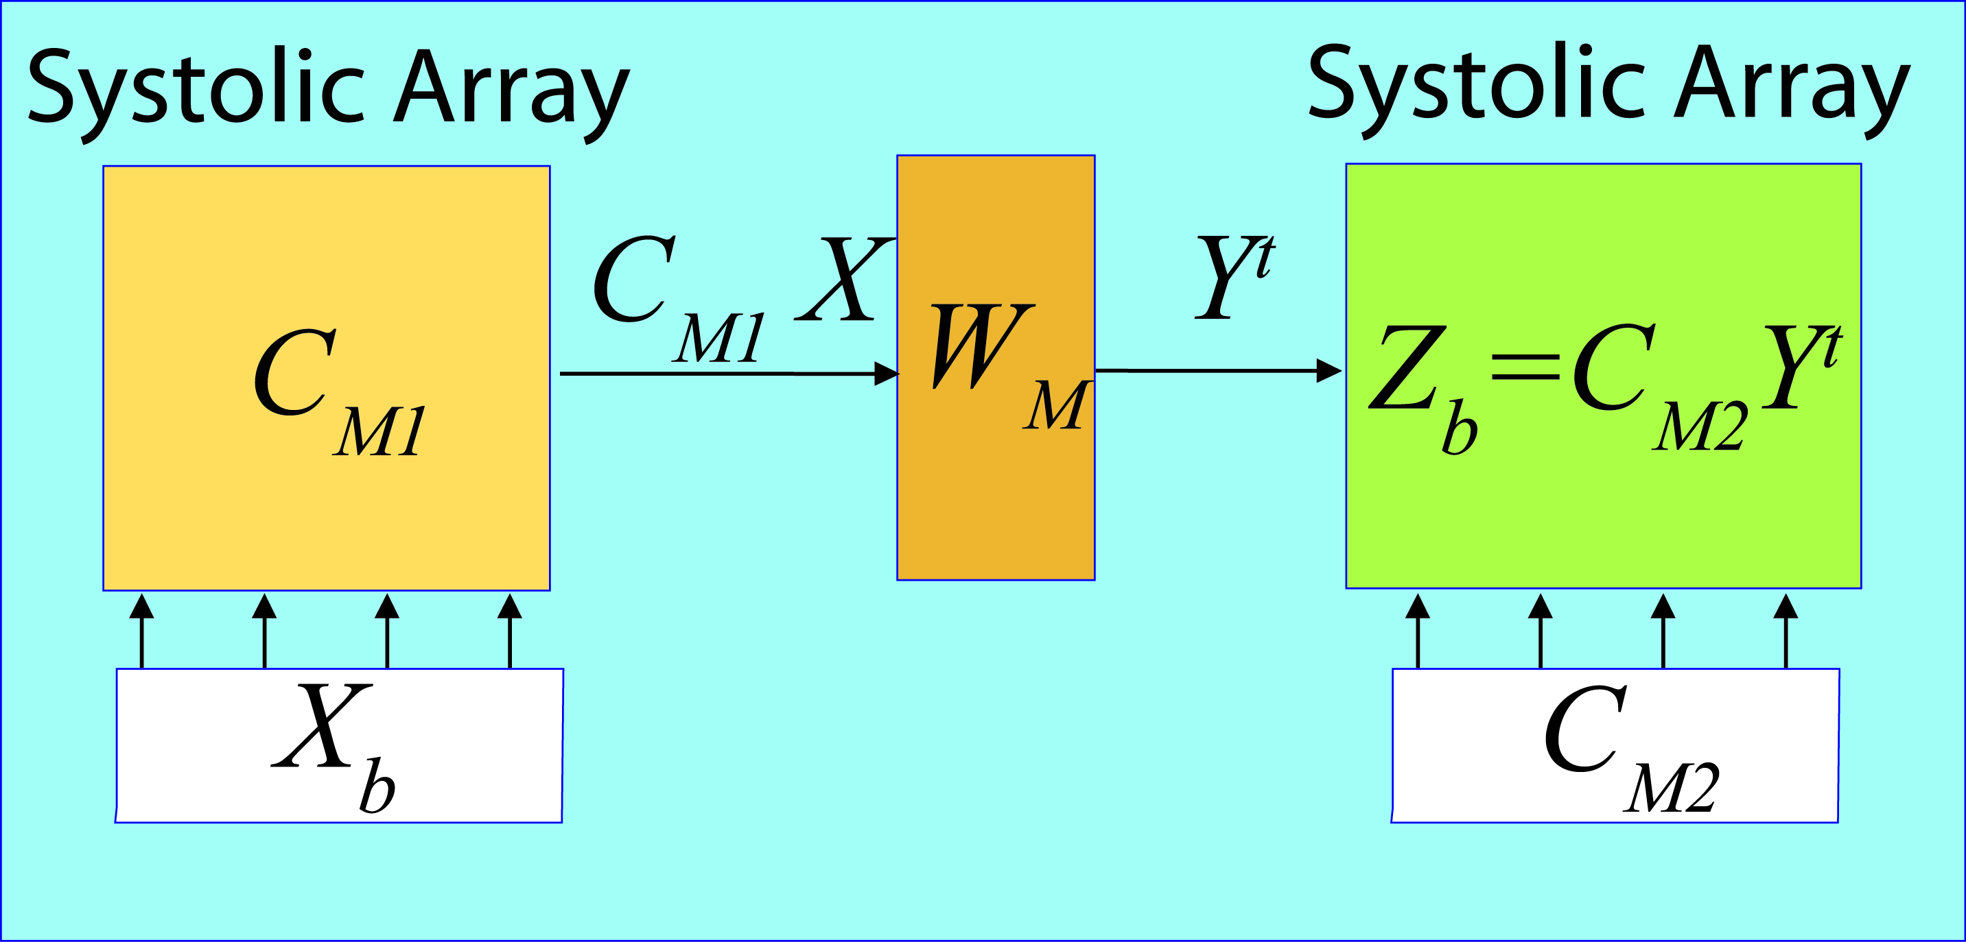
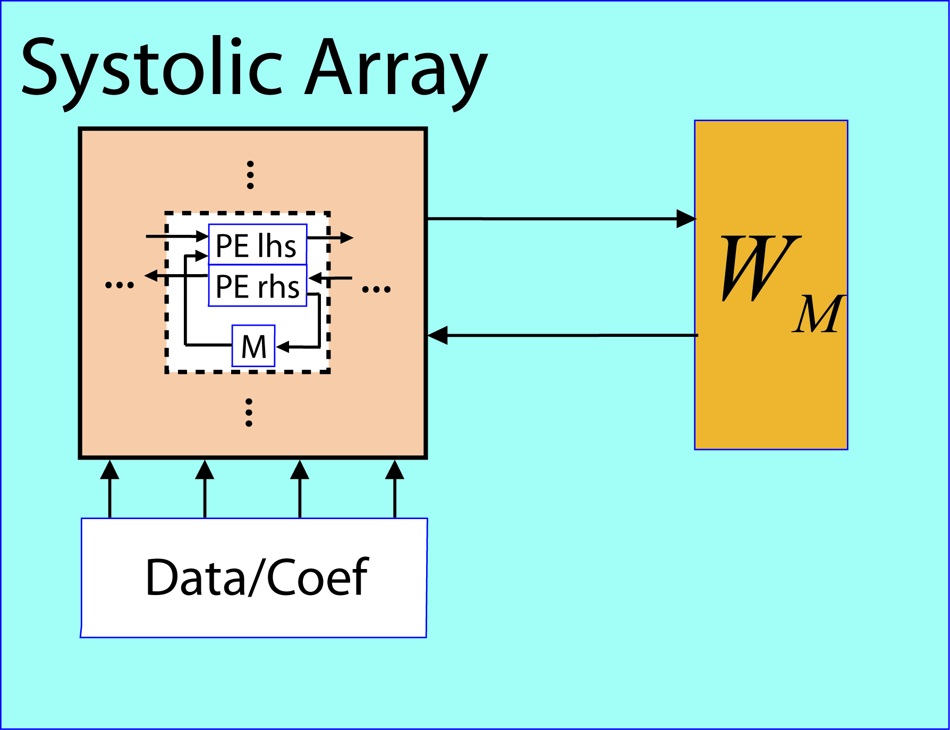
“Base-b” FFT Architecture
Base-b DFT equations:
Base-4 DFT architecture:
Virtual
Physical

Slide 10
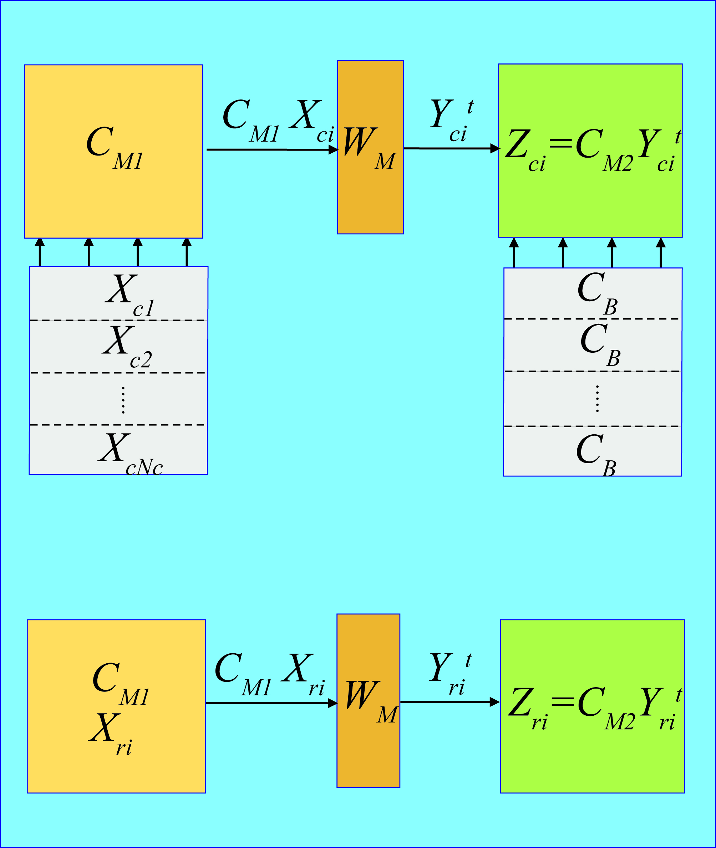
Processing flow for DFT of length N = N_{r} N_{c}
1. N_{c} column DFTs (X_{ci}) of length N_{r}
2. N_{r} row DFTs (X_{ri}) of length N_{c}

Slide 11
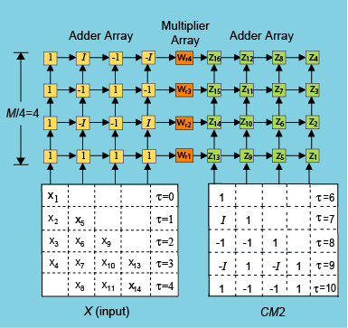
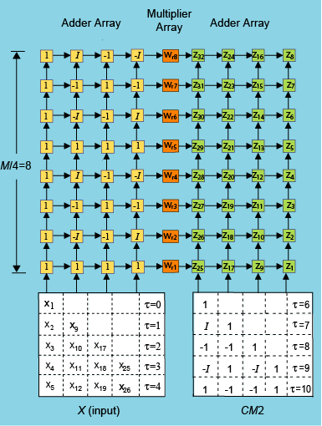
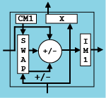

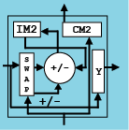
Base-4 Array Architecture
256 Point FFT (N_{r} =N_{c}=16)
1024 Point FFT (N_{r} =N_{c}=32)
Array Processing Elements

Slide 12
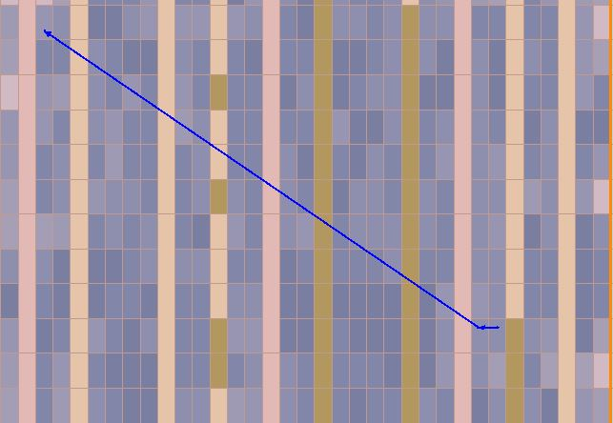
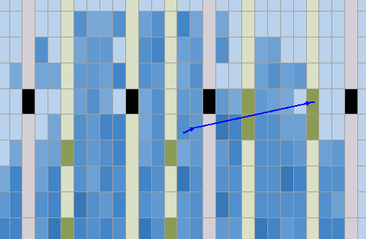
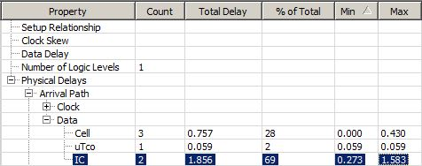
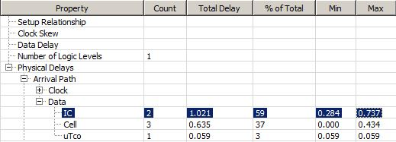
Interconnection Delays
65nm Technology: 256pt FFT
Altera Pipelined FFT
Systolic
Critical
Path
Fmax = 351 MHz
Fmax = 537 MHz

Slide 13
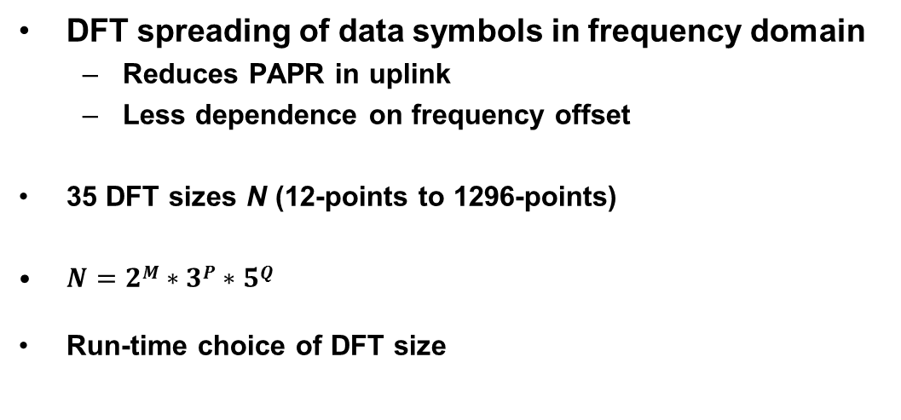
LTE Uplink: Single Carrier FDMA
DFT spreading of data symbols in frequency domain
  Reduces PAPR in uplink
  Less dependence on frequency offset
35 DFT sizes N (12-points to 1296-points)
$N=2M∗3P∗5Q$
Run-time choice of DFT size

Slide 14
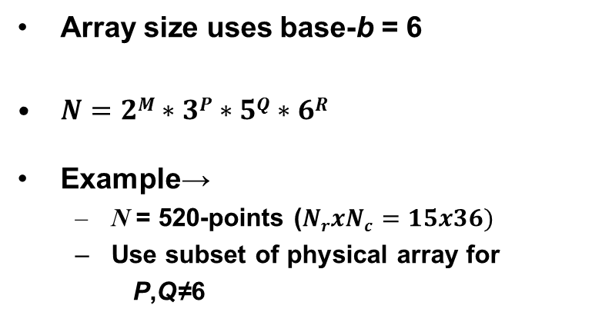
LTE Systolic DFT
Array size uses base-b = 6
$N=2M∗3P∗5Q∗6R$
Example→
  N = 520-points ($NrxNc=15x36)$
  Use subset of physical array for
  P,Q≠6
36-pt
DFTs
15-pt
DFTs

Slide 15
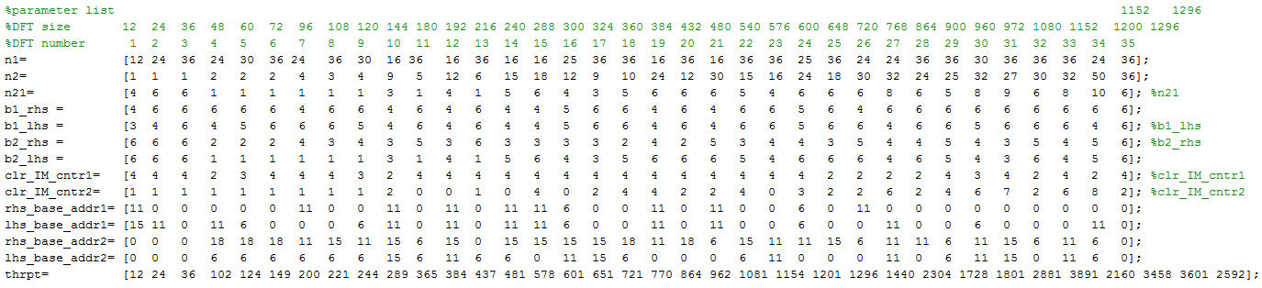
Programmability
Parameter List (Matlab):
  Matrix factorization parameters(a^{x},b^{y},c^{z},…)
  Addresses for coefficients
240 points

Slide 16
LTE DFT: FPGA Cycle Counts
 | Average Latency Time | Average Throughput Rate | Resource Block Computation Time
Altera | 1.39 | 0.47 | 2.01
Xilinx | 0.86 | 0.65 | 1.50
Systolic FFT | 1.00 | 1.00 | 1.00

Slide 17
LTE DFT: FPGA Circuit Usage Comparisons
(65nm Technology)
Design | FPGA | LUT | ALM /LE | Fmax
 |  |  |  | (MHz)
Systolic | Stratix III | 3582 | 2733 | 394
Xilinx | Virtex-5 | 4707 | 3864 | 276
Altera | Stratix III | 2600 | n.a. | 260
Chen | Virtex-5 | 7791 | n.a. | 123

Slide 18
LTE Systolic DFT: Performance Comparisons
Design | Average LTE Resource Block
 | Compute Time
Systolic FFT | 1.0
Xilinx | 2.1
Altera | 3.0

Slide 19
Fixed Size FFT: Power-of-two
Streaming (continuous data in/out)
Array size uses base-b = 4
Altera Stratix III FPGAs (65nm technology)
 | Altera | Systolic FFT | Altera | Systolic FFT
 | 20-bits | 16-bits | 20-bits | 16-bits
Transform Size | 256 | 256 | 1024 | 1024
ALMs | 4261 | 3982 | 4394 | 4331
Memory Bits (K) | 49 | 40.6 | 195 | 145
Multipliers (18-bit) | 24 | 33 | 24 | 33
SQNR | 76.6 | 86.7 | 81.3 | 82.8
Sample Rate (MHz) | 387 | 566 | 382 | 533

Slide 20
Variable Size FFT: Power-of-two
Transform sizes: 128/256/512/1024/2048-points
Streaming (continuous data in/out)
Run-time transform size
Array size uses base-b = 4
Altera Stratix III FPGAs (65nm technology)
 | Systolic FFT 16-bits in/16-bits out | Altera 16-bits in/30-bits out
Architecture | Systolic | Single Delay Feedback
ALMs | 4522 | 3826
RAM Memory (K) | 290 | 208
Multipliers (18-bits) | 33 | 36
Fmax (MHz) | 510 | 315

Slide 21
Conclusion: Better FFTs are Possible
Improved performance
  Algorithmic reduction in computation cycles
  Localized interconnects for high clocks speeds (>500MHz for 65nm FPGA technologies)
Reduced usage of FPGA logic cells
Programmability
Throughput scalability due to the use of systolic algorithms
Higher dynamic range (smaller word lengths needed)

